Slide 1

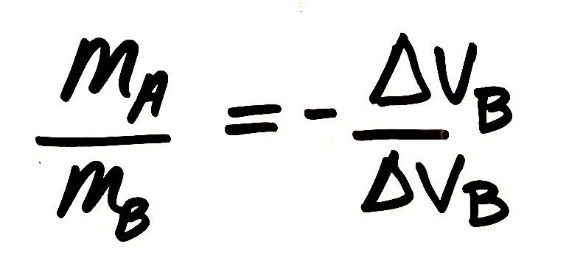
Navigate
Slide A
With your class
What were we wondering about this mathematical relationship at the end of our last class?
Notes:
Identify the questions we were considering at the end of last class. Display slide A. Discuss the related question about the equation shown on the slide as a class. See the prompts in the teacher guide for support.
Motivate testing additional conditions. Say, Let’s orient to a sim that you can use that will allow you to play around with all kinds of combinations to see if this relationship holds for any other collision conditions. You will need your whiteboard or a sheet of paper, a calculator, and a pencil or pen to do the calculations using the data you collect from the simulation.

Slide 2
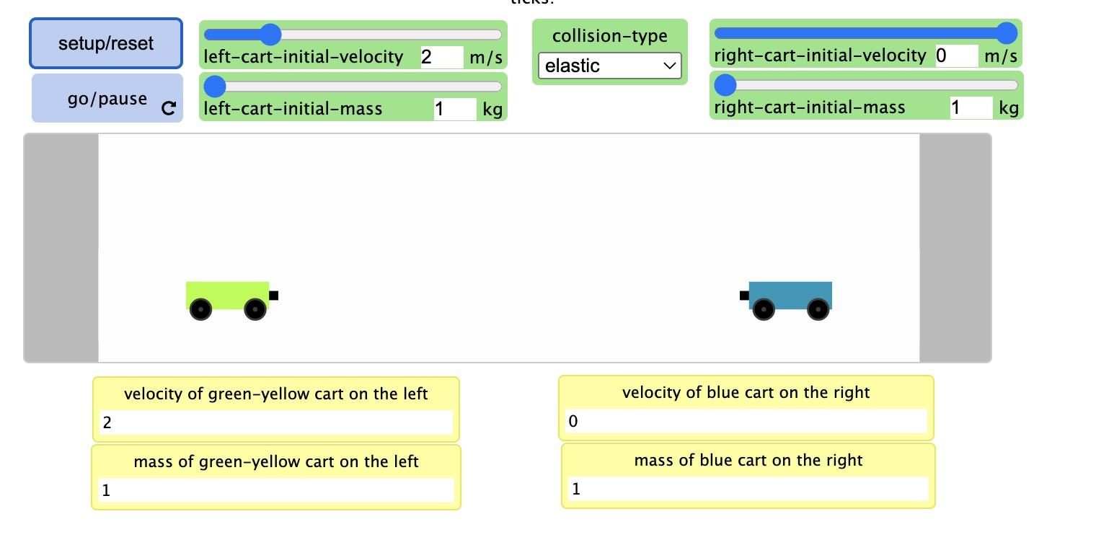
Plan an investigation
Slide B
With Your Class
Orient to a simulation that we can use to help us collect data on some of these other collision conditions.
Notes:
Orient to a new simulation. Display slide B. Point out the following interface elements that students can change in the simulation:
The two sliders that allow students to change the starting velocity of each cart.
The two sliders that allow students to change the mass of each cart.
The chooser that allow students to change the type of collision (elastic or inelastic)
The SETUP/RESET button which initializes a new model run using the values set in the sliders and chooser above.
The GO/PAUSE button that runs the model to produce the outcomes of the collison.

Slide 3

Carry out an investigation
Slide C
With a partner
Use the simulation to test at least one elastic collision and one inelastic collision
https://openscied-static.s3.amazonaws.com/HTML+Files/Inelastic+and+Elastic+Collisions.html
For each collision record the following:
The type of collision
The mass of each cart
The starting velocities of each cart
The final velocities of each cart
Notes:
Carry out an investigation. Display slide C. Review the directions on the slide. Share the url for the simulation video with students. Have students work with partners to carry out this brief investigation and record the related data. As students are doing this, distribute a white board, 2 white board markers, and a paper towel or whiteboard eraser to each partner.

Slide 4
Test our model
Slide D
With a partner
Does the mathematical relationship we discovered for Collisions E and F hold for none, one, or both of the collisions you tested in the simulation?
Use a white board to document your mathematical thinking for this.
Be ready to share your whiteboard with the whole class.
Notes:
Test our model. Pause students working with the simulation. Display slide D. Read through the directions. Tell students to use their calculators and to prepare documentation of their calculations on their whiteboard, so they will be easily visible to share these with the whole class in a few minutes.
Bring the class together to share whiteboard results for 5 minutes. Ask, Does the mathematical relationship we discovered for Collisions E and F hold for none, some or all the collisions we tested as a class? What do your results say? Students should come to an agreement that it holds for all the conditions they tested.

Slide 5
Use mathematical thinking
Slide E
With a partner
Try to simplify the mathematical relationship we figured out so that it no longer has fractions. What can you do to move the variables out of the denominators?
Be ready to share your whiteboard with the whole class.
Notes:
Simplify our equation. Point to the equation at the front of the room that equates the ratio of velocity changes to the negative, reciprocal for the ratio of their masses (pictured at right, top). Present slide E. Remind students that fractions are not always the easiest way to work with quantities. Ask students to work with a partner quickly to try to simplify the equation to move some of the variables out of the denominator.
Give students about two minutes to work this out on their whiteboards with a partner and then ask students to share out. On the board, as students share out, document the process of cross-multiplying to get the equation at right, center.
Summarize the equation and point out that there is a quantity that is conserved. Say, We have an equation here that fits our data, that shows us that in a collision, the change in velocity times the mass of the first vehicle is always going to be equal to the change of velocity times the mass of the second vehicle, but in the other direction, which is what the negative sign tells us. So the mass times velocity lost by the blue vehicle in this case, is going to be gained by the green one. That tells us that for this quantity we have been calculating, nothing has been lost from the system. And we can show that more clearly by moving all of the variables to one side of the equation and seeing that the total change across the system is zero.
Move the negative term to the other side of the equation at the front of the room, as shown at right, bottom.
Say, We have figured out that this quantity, mass times velocity, is conserved in a collision when we keep track of it for both objects in the system that collide with each other.

Slide 6

Recalling other conserved quantities
Slide F
Turn and Talk
Based on our work in prior units, what are some other physical quantities that are conserved?
Notes:
Turn and Talk briefly about conserved quantities. Present slide F. Give students under a minute to identify some other physical quantities that are conserved. Listen in, and then tell students, I heard ideas about conservation of energy, and mass. We definitely used those ideas in earlier units! And now we have found something else that is being conserved.
Develop a geometric representation. Say, Whenever we think about a conserved quantity in any physical process, it can be useful to try to represent that quantity using alternate visualizations beyond just numbers or symbols. Let’s try to visualize this quantity that is being conserved with a geometric model. A geometric model uses geometry, or shapes, to represent quantities in from an alternate representation visually. So we need a shape that will help represent a quantity that is the product of two variables.

Slide 7
Use mathematical thinking
Slide G
With Your Class
Prepare to develop a geometric way to visualize the quantity that is conserved (m * Δv)
Turn and Talk
What are some shapes you’ve used in the past to represent the quantity that is the product of two variables (a * b)?
Notes:
Present slide G. Cue students to Turn and talk to a partner about the related question on the slide:
What are some shapes you’ve used to represent the quantity that is the product of two variables in the past?
Give students a minute to talk with a partner as you wander around the room. Then say, I heard some shapes being suggested. One of those was a rectangle. Can someone tell me how the product of two variables can be represented by a rectangle? Look for ideas about how they have a base and a height and how the product of these represents their area.
If this idea doesn’t come out, or need further clarification, say something like, The product of two values can be conceptualized as the area of a rectangle where the base and height represent the values.
Let’s try and represent a certain amount of change in this quantity that a vehicle undergoes in a collision using a rectangle, where one side of the rectangle will represent its mass and the other side will represent its change in velocity.
Draw a rectangle with the variables on its sides as shown and the corresponding description.

Slide 8
Use mathematical thinking
Slide H
With Your Class
A 3 kg cart is stationary before a collision and it had a speed of 4 m/s after the collision.
How would could we use a rectangle to represent the amount of momentum change this object experiences?
Notes:
Represent the amount of change for one object. Let’s consider a situation where a 3 kg cart is stationary before a collision and it had a speed of 4 mph after the collision. Present slide H. Ask students how to represent the amount of momentum change using this geometric representation. Anticipated responses:
draw a rectangle with a base of 3 and a height of 4
it will have an area of 12, which represents the amount of change that object experiences.
Sketch and annotate the corresponding rectangle on the board: reference teacher guide.
Ask students to consider how much the velocity of the second cart should have changed if it had a mass of 6 kg. Students should say it should have changed by 2 mph. Sketch and annotate the corresponding rectangle on the board next to the first in red marker: reference teacher guide.
Ask students whether the change is an increase or decrease for this object if we know the sum total of the changes in the entire system has to be zero. Students will say it should be a decrease.
Suggest that we show a decrease by drawing the arrow going in the other direction from the reference line drawn at the top of the rectangle, so we can better visualize this as a decrease in the amount of this quantity for this second object. Add negative signs to the annotations as well to represent the change in velocity as -2 mphs, and the change in momentum as -12.
Represent the momentum change for a different second object. Ask students how we would draw this rectangle if the mass of the second cart was 1 kg, instead of 6. Students will say draw it as a rectangle that is 1 kg wide and goes down 12 mph from the reference line. Erase the red rectangle, its label, and calculate and redraw the following: reference the teacher guide.
Represent the momentum change for a different second object. Ask students how we would draw this rectangle if the mass of the 2nd cart was 24 kg. Students will say draw it as a rectangle that is 24 kg wide and goes down 0.5 mph from the reference line. Erase the red rectangle, its label, and calculate and redraw the following: reference the teacher guide.

Slide 9
Evaluate the geometric model
Slide I
With Your Class
What did the geometric representation help us visualize?
What were some of the limitations of the geometric representation?
Notes:
Evaluate the geometric model. Display slide I. Discuss the related questions as a class.
Name this quantity we are visualizing. Say, As scientists realized that this was a conserved quantity, they recognized they needed a way to that quantity more easily, so they assigned it a name. They called the quantity mass * change in velocity, a change in momentum. Add the following title and annotations on top of the prior equation you wrote. If this is your last class, start recording all of this on one poster paper, which you will reference in future activities and lessons as the Momentum relationships poster.
Refer to the Momentum relationships poster you made last period. Ask students to explain to a partner in their own words how this equation is related to what we’ve seen in our data so far.

Slide 10
Use mathematical thinking
Slide J
m * Δv is change in momentum.
It has two variables as well as a Δ symbol.
Let’s consider what momentum is, by recalling how we determine the change (Δ) for a single variable.
With Your Class
How did we use data to determine the change in a single variable (i.e. Δt, Δv)?
Notes:
Problematize what momentum is. Say, even though we have a relationship represented here that describes momentum change in collision that can account for our results, this raises a new question. If what is on the left side of the equation represents change in momentum in each object, then what exactly is momentum itself? Present slide J. Read the text on the slide, If m * Δv is change in momentum, then let’s consider what momentum itself is, by first thinking about what the Δ represents. Then discuss the related question as a class. See the prompts in the teacher guide for support.

Slide 11
Use mathematical thinking
Slide K
With a partner
What do our equation(s) predict the velocity of the car will be after the truck hits it in a rear end collision? What is Δv for the car?
Vehicle | Mass | Velocity before the collision | Velocity after the collision | Δv
truck | 6000 kg | 30 mph | 23 mph | -7 mph
car | 1000 kg | 3 mph | ? | ?
Notes:
Use the equation to predict the outcome of a vehicle collision. Say, Now that we know we can use any of these mathematical models to make predictions, let's see what it would predict for a real-world rear-end collision, between a moving truck and a stationary car. Display slide K. Instruct students to use their notebook to solve for this unknown. This should take just under 3 minutes for students to be ready to share their answers.
Compare answers. Students should agree that the velocity of the car after the collision is predicted to be 45 mph and the change in the velocity of the car should be 42 mph.
If time permits, follow-up by asking students how the ratio of the velocity changes compares to the ratio of the masses and how these compare to our earlier discoveries from the green and blue collision carts.

Slide 12

Add to your personal glossary
Slide L
On Your Own
Take a moment to add to or record a new definition for the following terms in your personal glossary:
Delta (Δ)
Elastic collisions
Inelastic collisions
Momentum
Notes:
Present slide L and give students time to add words and symbols they developed in this lesson to their personal glossaries. Some of the words students may decide to include are: delta (Δ), elastic collision, inelastic collision, momentum.
Motivate additional testing of the equation(s). Say, Any one of these equations seems to be pretty useful in helping us make predictions and think about whether they are consistent or not with other data we have collected. But we have still only analyzed a few types of elastic and inelastic collisions. Many of them were for the same types of vehicles, on the same track. There are so many other types of collisions that we have talked about. Let’s spend some time independently testing this relationship across a broader set of collision phenomena.

Slide 13
Use mathematical thinking
Slide M
On your own
Use our equations for momentum conservation to solve for unknown outcomes or conditions in three different collisions scenarios.
.
Be ready to share and turn in your responses at the end of class.
Notes:
Introduce the handout. Present slide M. Distribute the handout to each student. Emphasize the following:
Different forms of the momentum equation we developed in class are summarized on the first couple pages of the handout as reference for you..
Let’s see what other types of phenomena we can predict and explain with our momentum equations. Later pages of the handout provide 3 scenarios to try to apply these to.
At the end of the class we will compare the answers we get and the methods we used to determine how confident we are in using these momentum equations.
Give students the remaining time to complete the handout.

Slide 14
Self-assess and reflect
Slide N
On your own
Use the key to self-assess your work.
Complete questions A-C to help identify part of the process you feel confident about and parts you’d like additional practice or help with.
Turn in both handouts when you are done.
Notes:
Self-assess understanding and confidence. Present slide N. Distribute the handout to each student. Say, This key asks you to reflect on your confidence solving these equations. How could doing so help us as learners? Accept all answers.
Emphasize the following:
Use the key to self-assess your work.
Complete questions A-C to help identify part of the process you feel confident about and parts you’d like additional practice or help with.
This will provide you (the teacher) the ability to provide timely and targeted feedback, help, and additional practice. Say, We will have additional opportunities to talk and work together to address areas where you all identify needs.
Collect both handout 3 and handout 4 when students are done.
Reference an element of a science and engineering practice we used in our work. Point to the Relationships between variables for 2 colliding objects poster to emphasize that we have identified a quantitative relationship between mass and velocity, which we now can name as being related to momentum. Point out that it wasn’t until we started drawing rectangles to visualize two variables at once that we saw evidence for a new mathematical relationship. Remind students that different mathematical representations are sometimes needed to identify different patterns.
Consider possible quantitative relationships between other variables. Say, We uncovered a quantitative relationship between mass and change in velocity in a collision. And that relationship turned out to be really productive for predicting what will happen in a collision, in terms of how fast something will be moving, or how fast it was moving before.
Point to the Relationships between variables for 2 colliding objects poster again. Ask, What about these other variables we identified, like force or delta t? How can we use what we figured out about change in momentum (mΔV) to make predictions about the connections to these other variables we are interested in?

Slide 15
Navigate
Slide O
Turn and talk
How can we we use what we figured out about change in momentum (mΔV) to make predictions about the connections to other variables we are interested in?
F the force applied to an object
Δt the time over which the force is applied
Be ready to share these with the whole class.
Notes:
Present slide O and give students a couple of minutes to talk with a partner.
Forecast our purpose next time. Let’s come back to this question and see if we can start exploring other possible relationships between these variables next time using some physical carts and other equipment I have that we can work with for you to collect data from in our classroom.

